Slide 1
RESORT BOOKING SYSTEM (NAMASTE WANDERER) BACHELOR OF TECHNOLOGY IN INFORMATION TECHNOLOGY
Submitted by
K.DEVIKA 16121A1261
K.MAANVITHA 16121A1262
L.M.MANJESH 16121A1263
L.NISHANTH 16121A1264
M.CHANDRIKA 16121A1265
M.G.PREETHI 16121A1266
MADHUMITHA AKKARAJU 16121A1267
M.LAHARI 16121A1268
N.THAPASWI 16121A1269

Slide 2
contents
S.NO TITLE
Abstract
1 Introduction
2 Modules
3 Concepts Required
4 Hardware & Software Requirement
5 Outputs
Conclusion & Future Work
Role of individuals
References

Slide 3
ABSTRACT
The project NAMASTE WANDERER speaks about the online system of booking a suit in hotel. This project is designed to override the problems prevailing in the current existing manual system of booking a suit. The project helps to reduce hardships faced by the existing system. The project is implemented in such a way that it carries out the operations in a effective and smooth manner.
The interface of the project is user friendly as the user can find no difficulty in using the website. The project is error-free, secure, reliable and fast management system. Instead of maintaining all the details manually it allows the management to store the in a database which can be retrieved at anytime easily.

Slide 4
1. Introduction
The main objective of this project is to automate the existing manual system by the help of computerized methods and software so that the users data can be stored and accessed easily and save the valuable time.
The project allows the user to book a room, order food online and also to search for any scenic trails nearby. Further it provides the route maps as a guide to reach the places the user wishes to visit. It keeps a record of all the details about bookings, food orders , payments.

Slide 5
1.1 functionalities
Provides the searching facilities for hotels, rooms, food orders, scenic trails.
Manages customer details online for booking and payment purpose.
Manages the information of rooms availability.
Manages the menu for any food orders.
Manages the list of places that can be visited nearby.
Provides the guidance route maps for the users.
Deals with the information and billing of payments.

Slide 6
2. Modules
This project mainly involved two modules
2.1 Hotels
2.2 Restaurants

Slide 7
2.1 Hotels
This is the first module in the project which helps users in order to sign up into the website and visit the hotel before booking itself. It enables user to visit the entire hotel along with rooms and all facilities inside the hotel so, that it provides user a friendly environment. In this module provides the option to select the room which user want to visit later if user wishes to book the room they can proceed booking procedure from that page itself.

Slide 8
2.2 Restaurant
This is second module in this project which provides customers a easy way to order food items in the hotel website itself. Here also it provides users a flexibility of seeing the item and also reviews regarding the item before ordering it. And if users feel like tasting it they can order it from the website itself

Slide 9
3. CONCEPTS REQUIRED
3.1 HTML
3.2 JavaScript
3.3 JQuery
3.4 PHP

Slide 10
3.1 HTML
<input>Defines an input control
<textarea>Defines an multiline input control such as address
<button> Defines a clickable button through which we can navigate to other file on click
<img>Defines an image to be inserted in html page
<a>Defines a hyperlink or displays a hyperlink on page
<link>Defines the relation between html and external source, we can include style sheets Scripts through link tag.
<style>Defines style of the html, used to define backgrounds, fonts, text etc.
<script>Defines a client-side script, we can validate a form using script.
<div>Defines a section in document, we can divide the html page into sections using this tag.
<span> Defines a section in document, we can apply styles to all elements present in span.

Slide 11
3.2 JAVAscript
/W/ Defined to check the white spaces in the textbox.
/d/ Defined to check whether the textbox contains only digits.
/[a-z][A-Z]/ Defined to check whether the textbox contains only alphabets.
/^\w+([\.-]?\w+)*@\w+([\.-]?\w+)*(\.\w{2,3})+$/
Defined to check the email address is valid or not.

Slide 12
3.3 jquery
Click():The click() method attaches an event handler function to an HTML
element.The function is executed when the user clicks on the HTML element.
Dblclick() :The dblclick() method attaches an event handler function to an HTML
element.The function is executed when the user double-clicks on the HTML element.
Mouseenter(): The mouseenter() method attaches an event handler function to an HTML element.The function is executed when the mouse pointer enters the HTML element
Mouseleave(): The mouseleave() method attaches an event handler function to an HTML element.The function is executed when the mouse pointer leaves the HTML element
Mousedown():The function is executed, when the left, middle or right mouse button is pressed down, while the mouse is over the HTML element.
Mouseup():The mouseup() method attaches an event handler function to an HTML element.The function is executed, when the left, middle or right mouse button is released, while the mouse is over the HTML element.
Hover():The hover() method takes two functions and is a combination of the mouseenter() and mouseleave() methods.
Focus():The focus() method attaches an event handler function to an HTML form field.The function is executed when the form field gets focus.
Blur():The blur() method attaches an event handler function to an HTML form field.The function is executed when the form field loses focus.

Slide 13
3.4 php
mysqli_connect() Function:The mysqli_connect() function opens a new connection to the MySQL server.
mysqli_query() Function: The mysqli_query() function performs a query against the database.
mysqli_num_rows() Function: The mysqli_num_rows() function returns the number of rows in a result set.
mysqli_fetch_assoc() Function: The mysqli_fetch_assoc() function fetches a result row as an associative array.
mysqli_close() Function: The mysqli_close() function closes a previously opened database connection.
Session_start(): When you work with an application, you open it, do some changes, and then you close it. This is much like a Session. The computer knows who you are. It knows when you start the application and when you end. But on the internet there is one problem: the web server does not know who you are or what you do, because the HTTP address doesn’t maintain state.Session variables solve this problem by storing user information to be used across multiple pages. By default, session variables last until the user closes the browser. So Session variables hold information about one single user, and are available to all pages in one application.
number_format() Function: The number_format() function formats a number with grouped thousands.
get(): Information sent from a form with the GET method is visible to everyone.
post(): Information sent from a form with the GET method is not visible to everyone .

Slide 14
4. Hardware and software requirements
4.1 Hardware requirements:
PROCESSOR : 2.4 GHZ PROCESSOR SPEED
MEMORY : 2GB RAM
DISK SPACE : 500GB
4.2 Software requirements:
OPERATING SYSTEM : WINDOWS
FRONT-END : HTML,CSS
BACK-END : PHP,MYSQL

Slide 15
5 outputs
The following slides have the webpages that are associated with the project

Slide 16

FIG 1: The home page

Slide 17
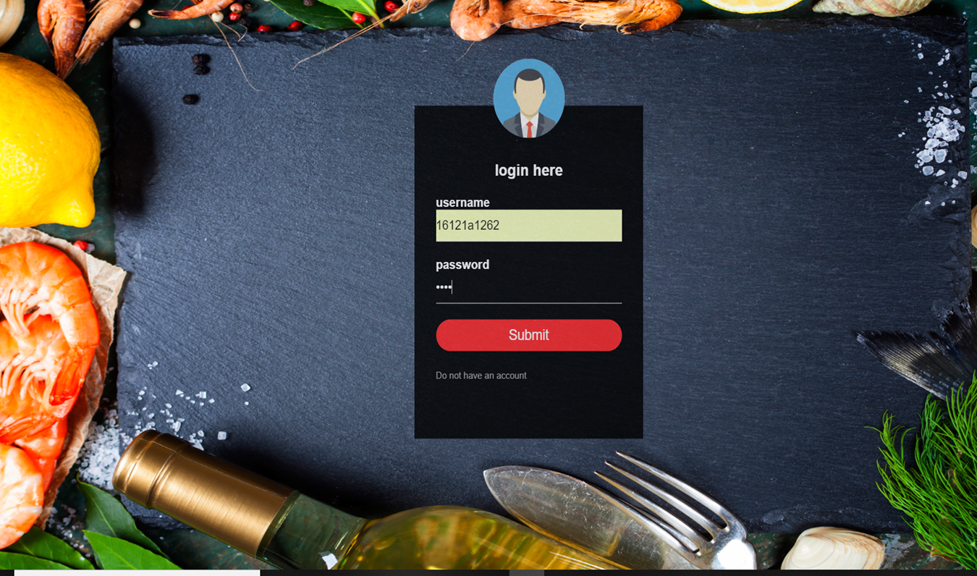
FIG 2: THE LOGIN PAGE

Slide 18

FIG 3: FOR BOOKING FOOD ONLINE

Slide 19
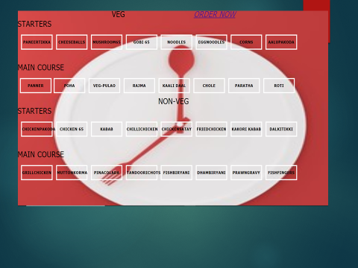
FIG 4 : THE MENU OF ITEMS

Slide 20
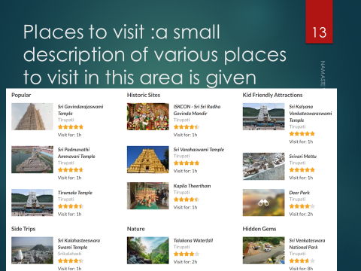
FIG 5 : THE LIST OF PLACES TO VISIT NEARBY

Slide 21
6. Conclusion and future work
The online resort management has got clear advantage over the manual system. The computerized system is more reliable, efficient and fast at the end of the project, I can say that computer play a very crucial role in the development of firm. All the daily reports generated by the system are to be checked by the concerned official so as to ensure that all the transactions have been put through in appropriate accounts and this is tallied with the new vouchers.
The online management system does maximum work with in minimum time. Because it is used in every field so that it provides comfort and suitability to everyone. Providing maximum facilities and comfort to customers to customers is main goal of the firm.
To achieve this goal, other modern facilities relating to computer should have to be provided.
The project can be further more extended by making NAMASTE WANDERER as one of the finest resorts by providing the customers with more cities to provide the services by making it one of the holiday planning resorts.

Slide 22
Role of individuals
NAME | ROLE | MODULE
K.DEVIKA | DESIGNER | RESTAURANT
K.MAANVITHA | DEVELOPER | RESTAURANT
L.M.MANJESH | DESIGNER | RESTAURANT
L.NISHANTH | DESIGNER | HOTEL
M.CHANDRIKA | DEVELOPER | HOTEL
M.PREETHI | DESIGNER | HOTEL
A.MADHUMITHA | DEVELOPER | RESTAURANT
M.LAHARI | DESIGNER | RESTAURANT
N.THAPASWI | DEVELOPER | HOTEL

Slide 23
references
Thomas A. Powell Tata McGraw Hill, Fifth Edition, 2010.
Andrea Tarr, "PHP and MySQL," Willy India, First Edition, 2012.
https://www.w3schools.com/html/html5_webstorage.asp
https://www.tutorialspoint.com/php/php_sessions.htm
https://codeclubprojects.org/en-GB/webdev/

Slide 24
THANK you

